Slide 1
Batch KK

Slide 2
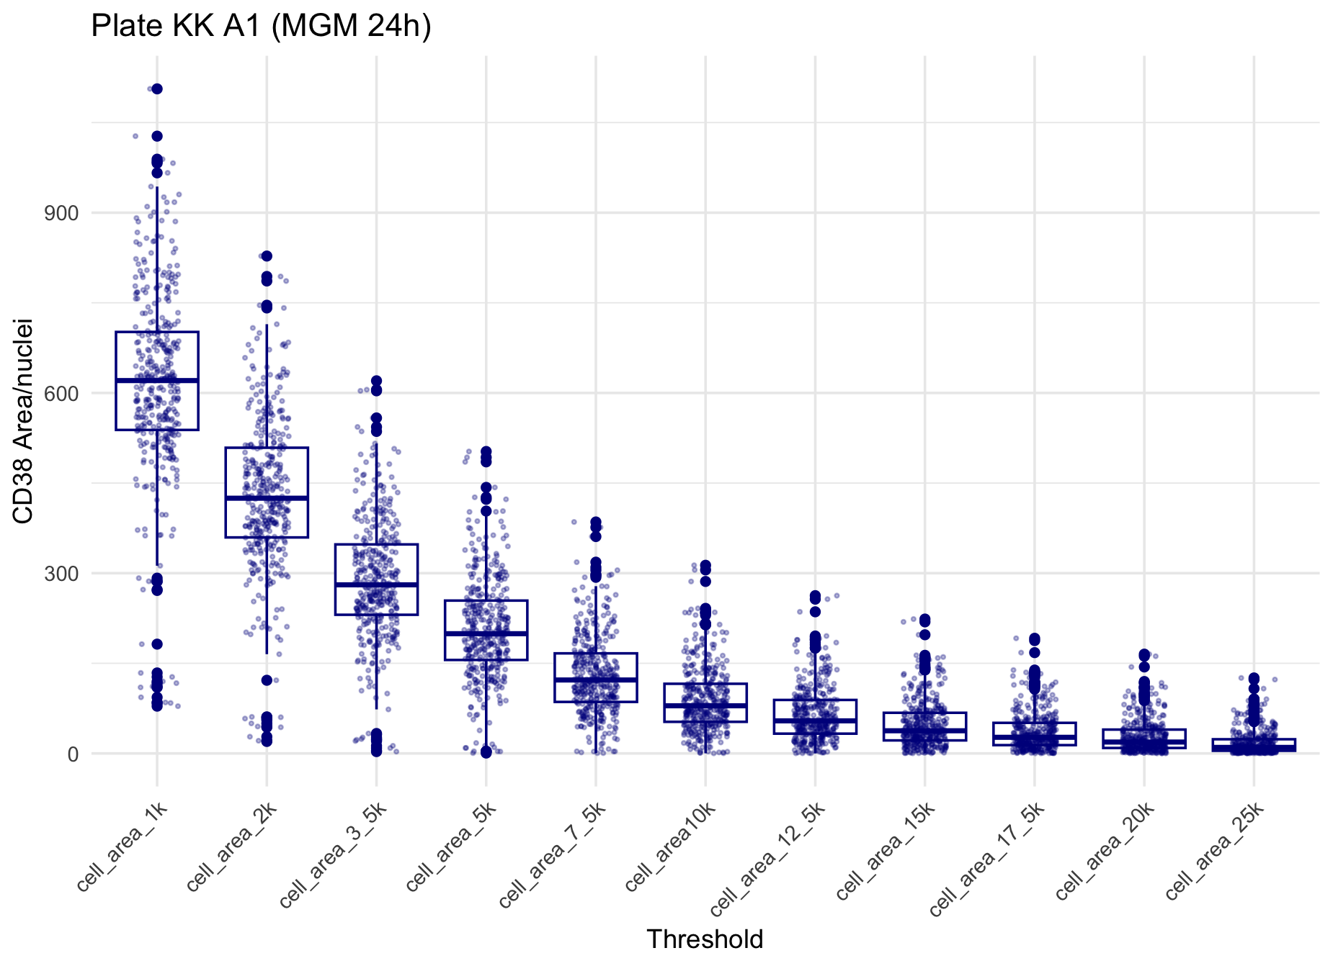
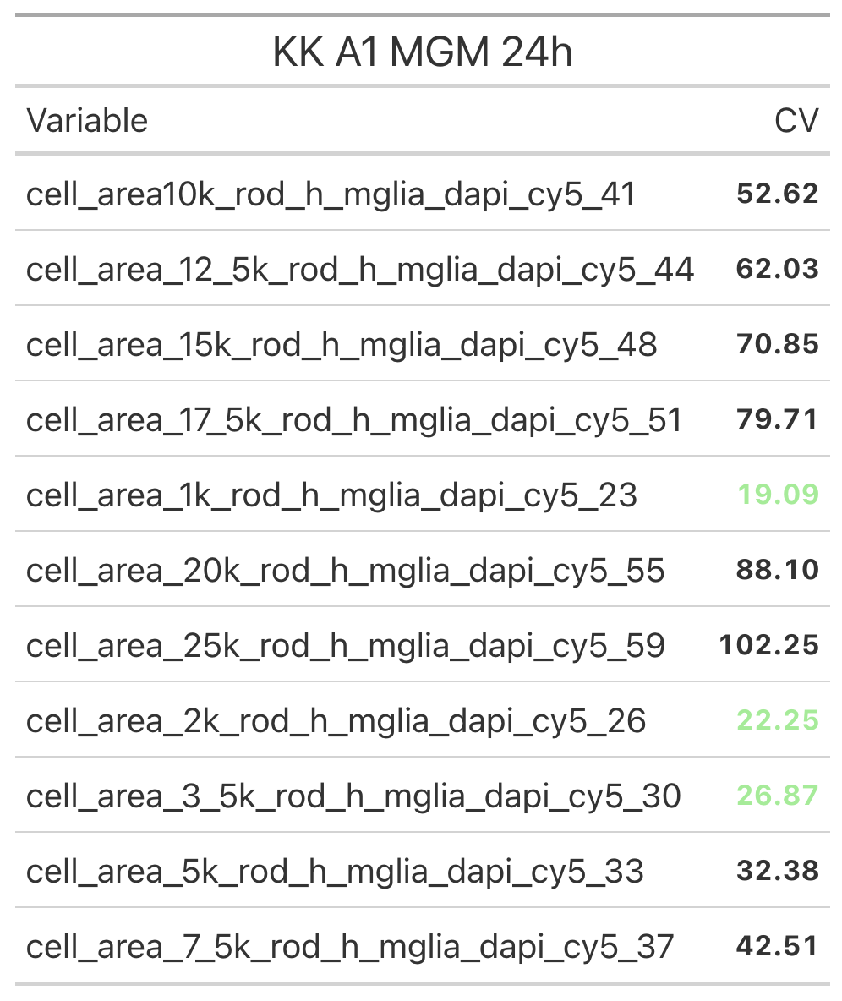
A1: All thresholds in Defined Media (with edges)
Microglia inflammatory activity = area of fluorescence intensity per nuclei count
(CV based on max. signal)
Notes:
Graph includes all conditions. CV only max signal (dmso/LPS)

Slide 3
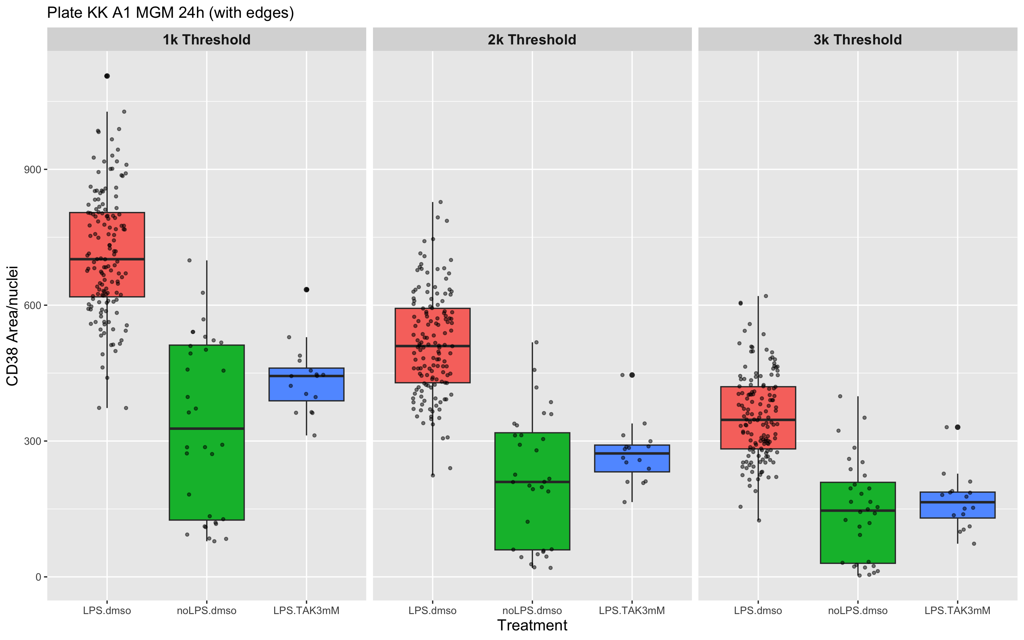
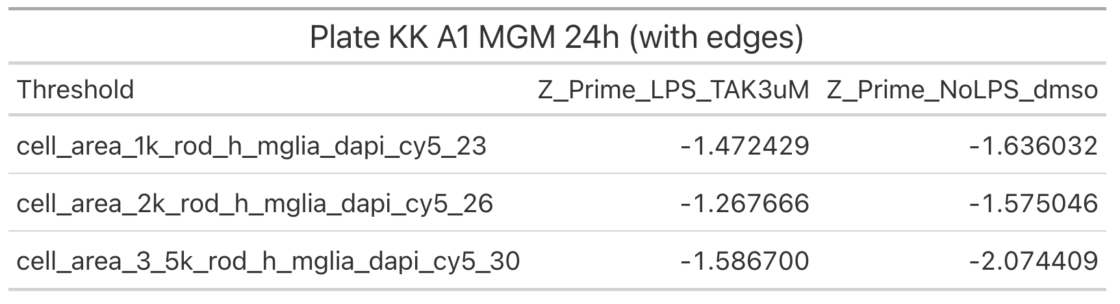

A1: Control Data (with edges)
Z’: Quantifying the quality of our screening assay
$$1 − \frac{3(σ_{p}+ σ_{n})}{|μ_{p} − μ_{n}|}$$
Zhang et al., 1999
Notes:
Make colour blind friendly

Slide 4
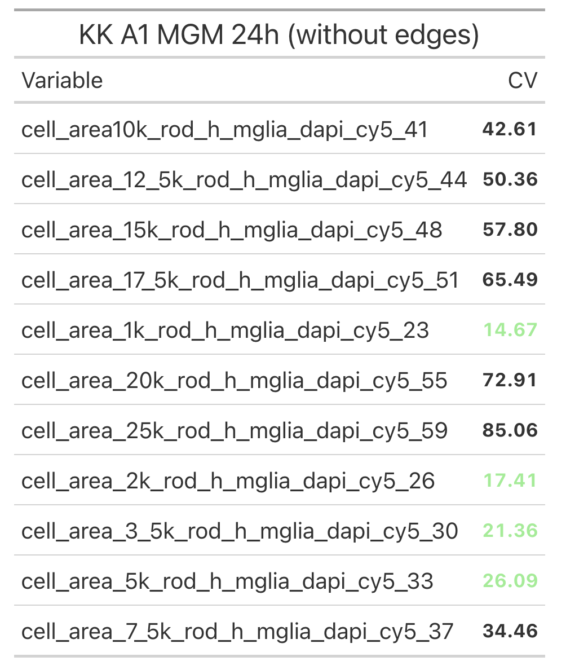
A1: Comparing CV’s
with edges
without edges

Slide 5
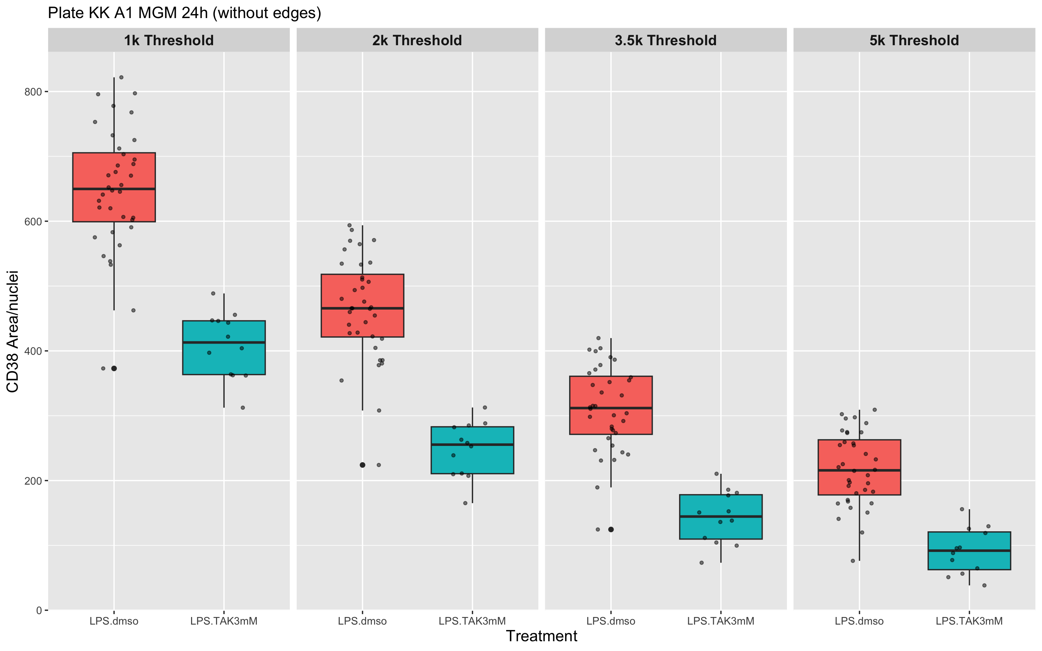
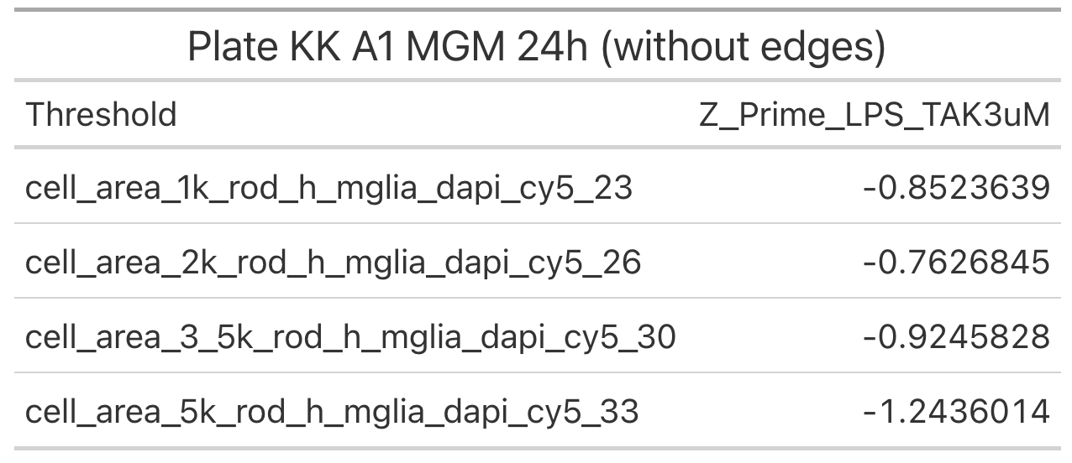
A1: Control Data (without edges)

Slide 6
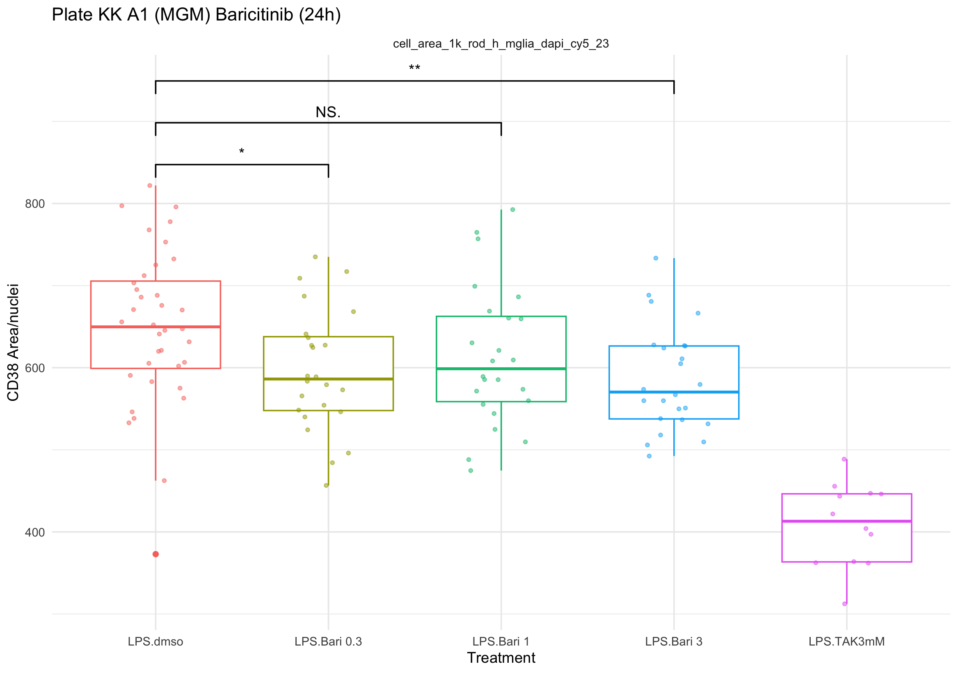
A1: Compound Data - Baricitinib
1K Threshold
(without edges)
Notes:
Perform 1 way anova

Slide 7
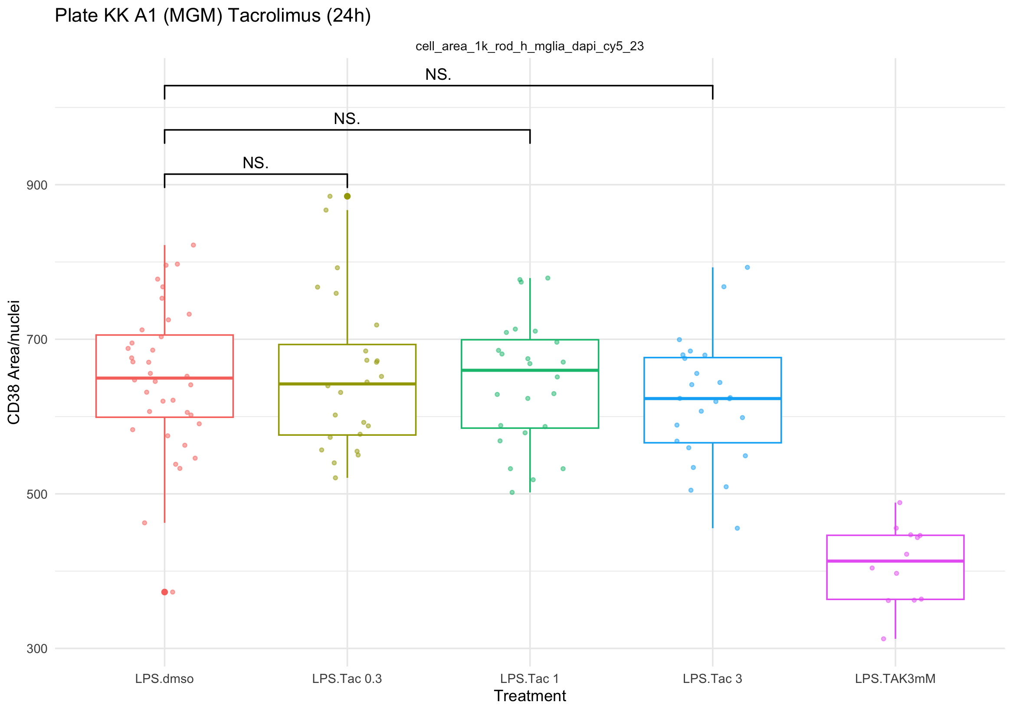
A1: Compound Data - Tacrolimus
1K Threshold
(without edges)
Notes:
Perform 1 way anova

Slide 8
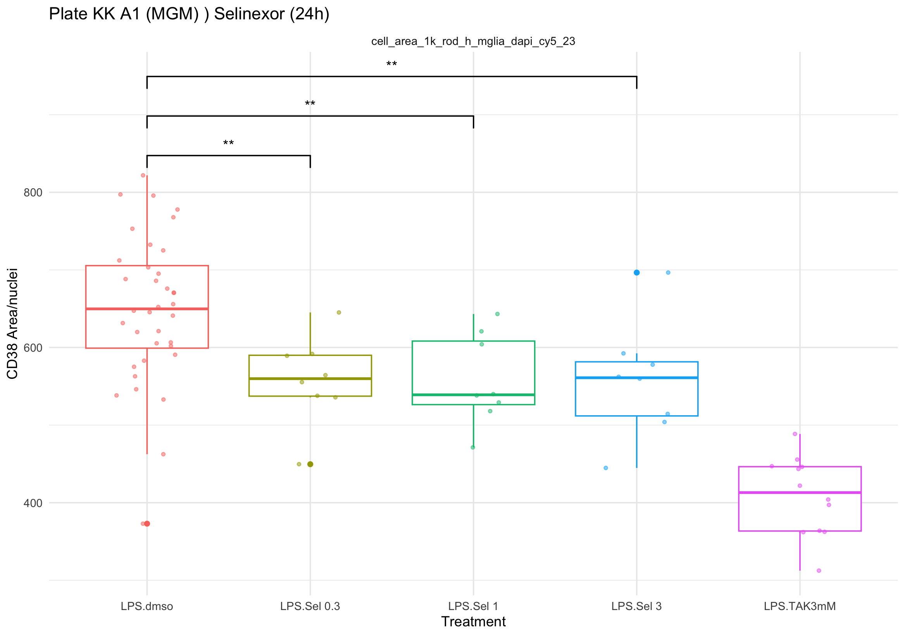
A1: Compound Data - Selinexor
1K Threshold
(without edges)
Notes:
Perform 1 way anova

Slide 9
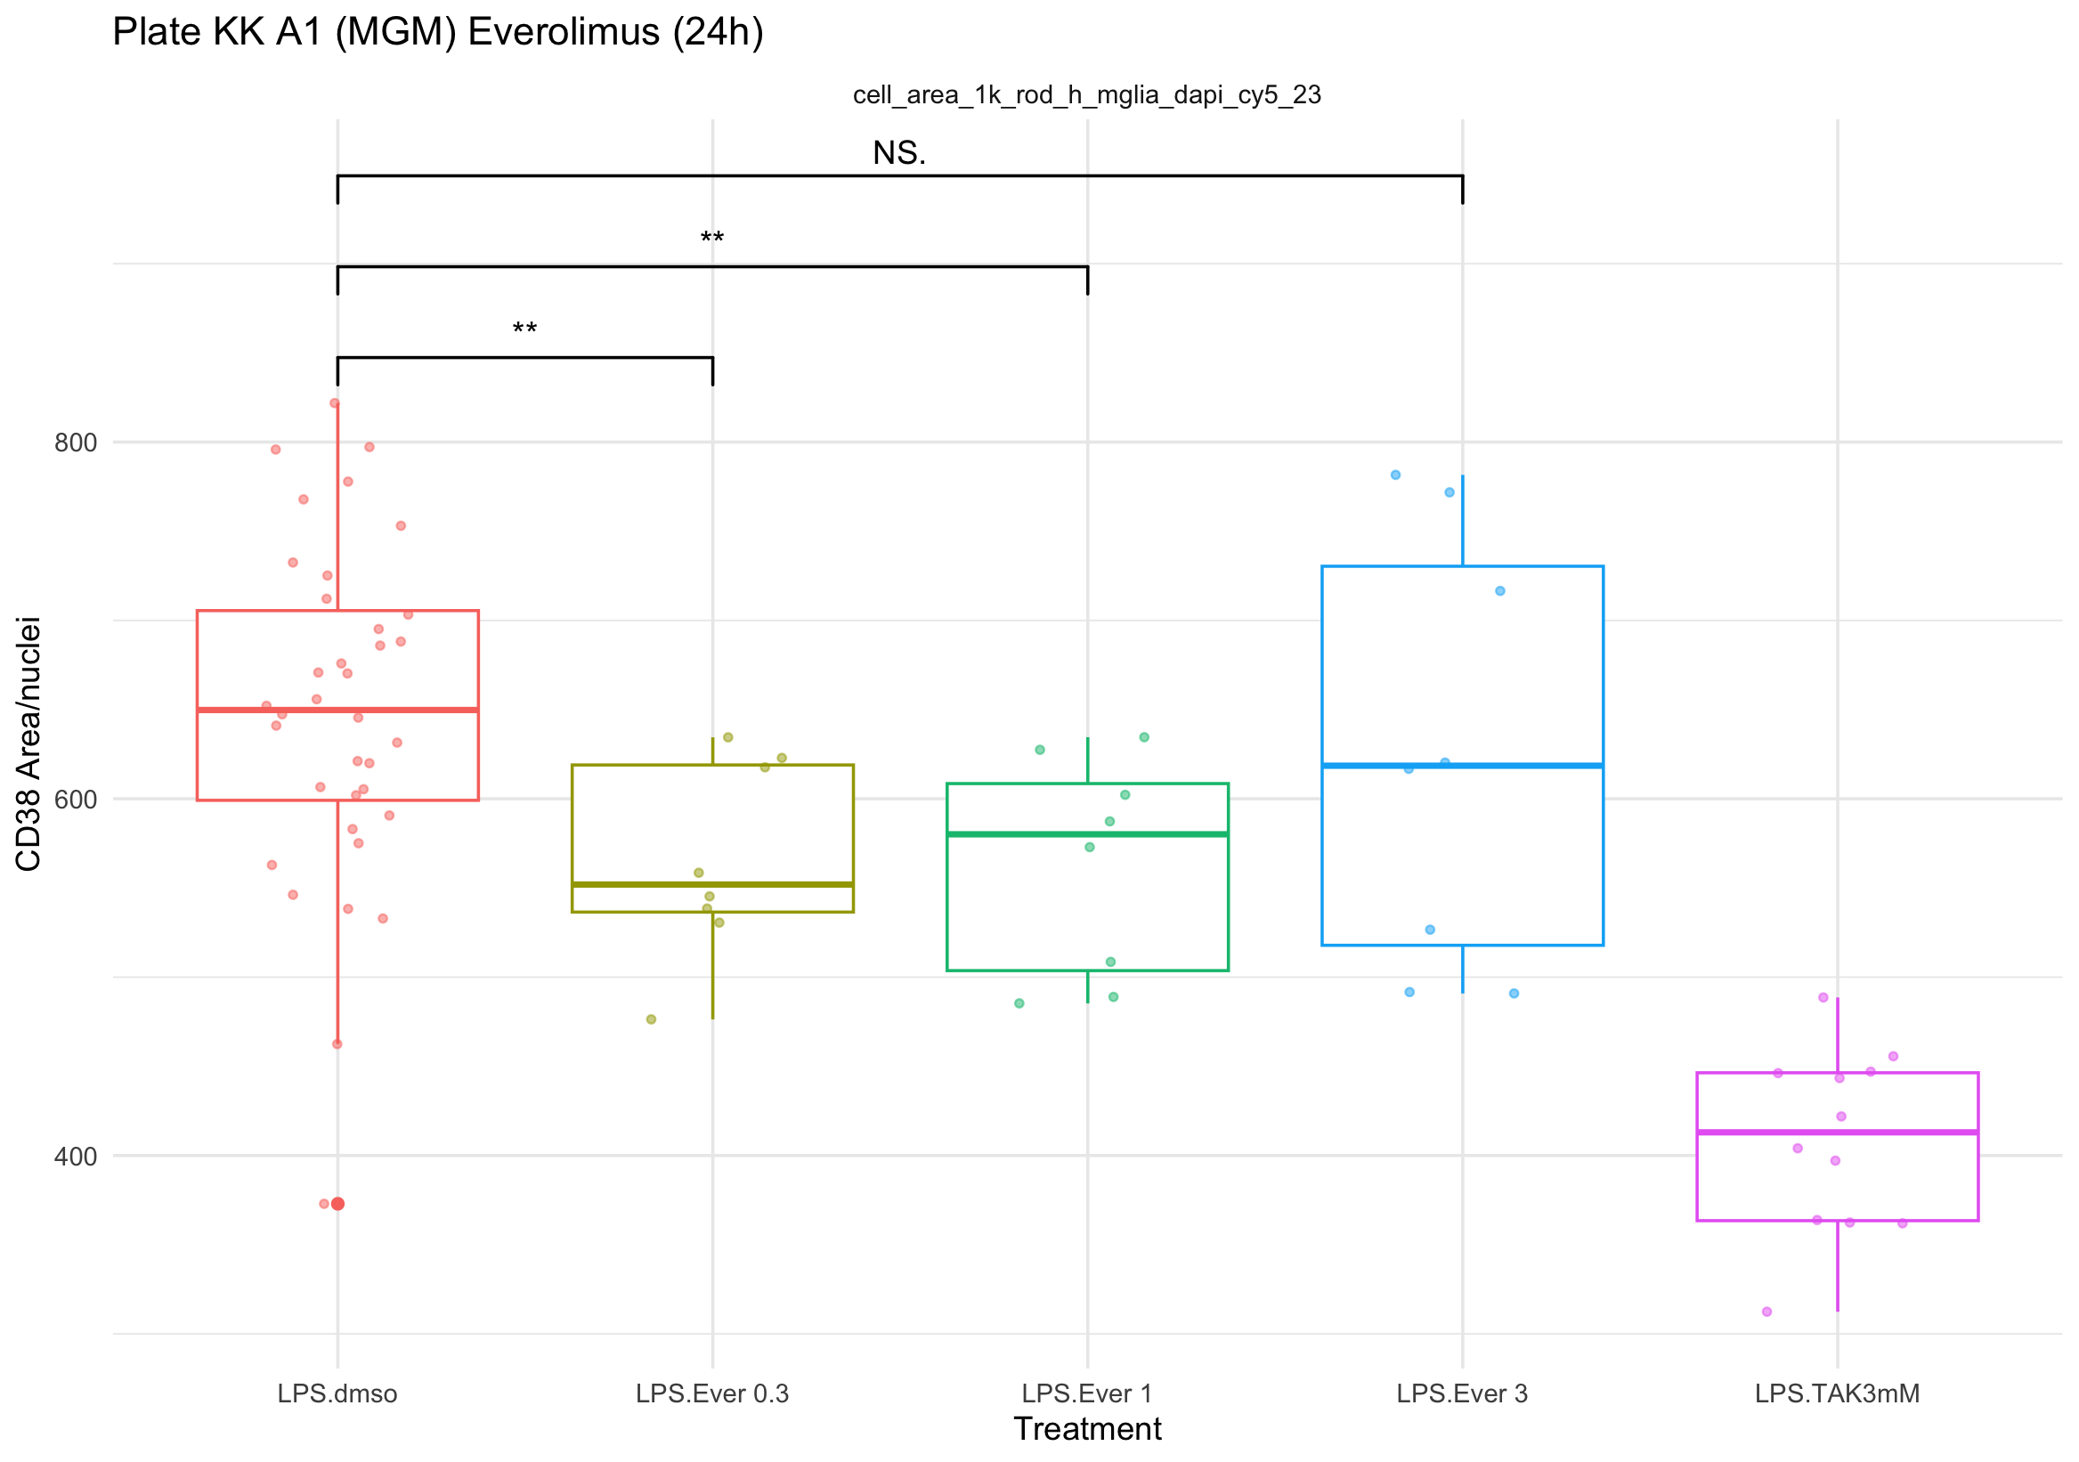
A1: Compound Data - Everolimus
1K Threshold
(without edges)
Notes:
Perform 1 way anova

Slide 10

Thank you for listening
Name Position Contact email or Slack details
Name Position / Role
Name Position / Role
Name Position / Role
Name Position / Role
Collaborator institution Name (Position / Role) Name (Position / Role) Name (Position / Role)
Collaborator project Name (Institution) Name (Institution Name (Institution

